Slide 1



Applied Data Analysis (CS401)
Lecture 3
Visualizing data
4 Oct 2023
Robert West
Notes:
2020: Timing good: 92 minutes (shortened break to 13 minutes)
2021: Similar
2022: 94 minutes (15 min break)
2023: 88 minutes (13 min break)

Slide 2
Announcements
You must find 4 team mates and register by this Fri 6 Oct 23:59
Every student must register individually
Still looking for a team or for team members? Use Ed! If need be, talk to Sepideh [TA]
Project milestone 1 was released last Fri; due Fri 13 Oct 23:59
Homework 1 released Fri 13 Oct (due two weeks later)
Friday’s lab session:
13:15–13:30 (on Moodle): Quiz 2 (the first one that counts)
13:30–14:30: Project milestone P1 office hours (Zoom)
In parallel: Exercise on data visualization and working with data from the Web
Notes:
- Zoom: https://epfl.zoom.us/my/josifoski
- Two TAs, Martin and Akhil, will be there in separate breakout rooms to answer your questions. Please join either of the rooms based on the load (#participants visible to everyone).

Slide 3
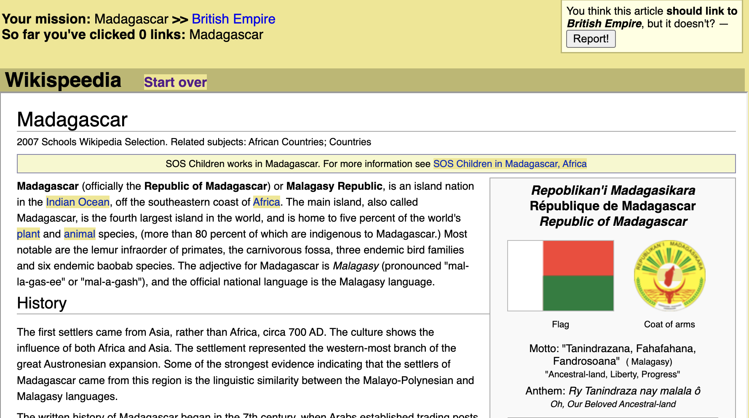
Announcements
Want to contribute to a (fun!) research study? https://go.epfl.ch/wikispeedia_LLM_ada_doc

Slide 4
Feedback
Give us feedback on this lecture here: https://go.epfl.ch/ada2023-lec3-feedback
What did you (not) like about this lecture?
What was (not) well explained?
On what would you like more (fewer) details?
What’s your favorite color, baby?
…

Slide 5
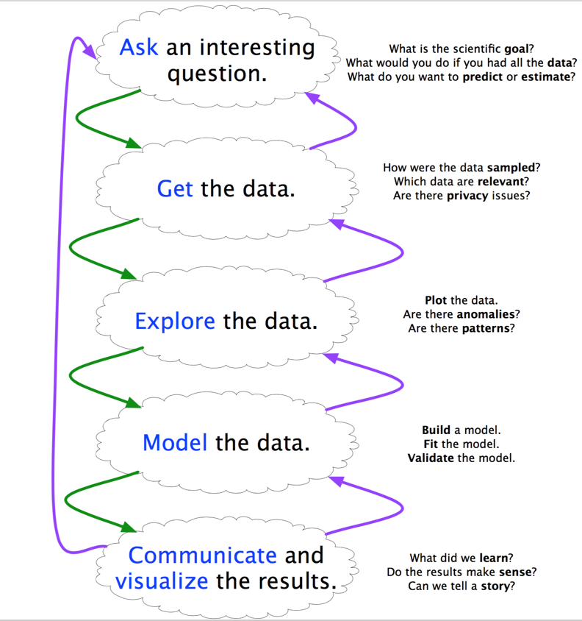
Uses for data visualization
Support reasoning about information (analysis)
Finding relationships
Discover structure
Quantifying values and influences
Should be part of the data analysis cycle
Inform and persuade others (communication)
Capture attention, engage
Tell a story visually
Can focus on certain aspects and omit others
Make it easier to evaluate potential courses of action (decision-making)
Notes:
Viz matters throughout data science: 3 broad classes of use cases:
…
Before and during analysis
After analysis
After analysis

Slide 6
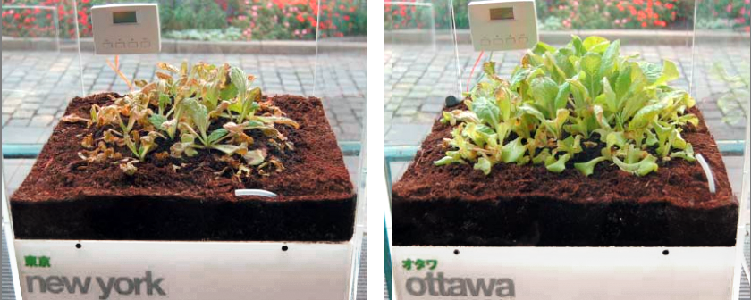
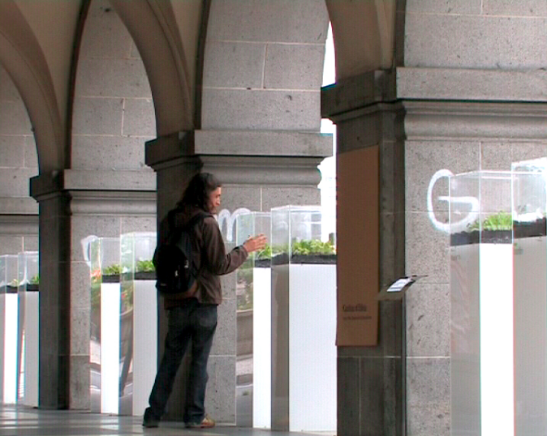
An unconventional example
“Garden of Eden”: 8 lettuces, each of which is enclosed in its own airtight plexiglas box and represents a major city. The concentration of ozone in each box is controlled in real-time to reflect the current pollution level in the city.

Slide 7
Static viz
Interactive viz
More and more common when delivering the results (and also during exploration). New frameworks are the key enabler.
Great for data exploration, developed throughout the last few centuries…
Notes:
Previous ex. highly non-traditional viz – but still a viz
More traditional: static
Now more and more interactive (but w/ a computer, not plants…)
In this lecture, will focus on static viz
Without these basics, won’t be successful at interactive viz

Slide 8
Want to learn more?
Dedicated course:
COM-480: Data Visualization
Notes:
Including about interactive viz

Slide 9
Today’s lecture
Part 1: Navigating the chart landscape
Part 2: Principles and best practices
Part 3: A (small) selection of use cases for data visualization

Slide 10
Part 1
Navigating the chart landscape

Slide 11
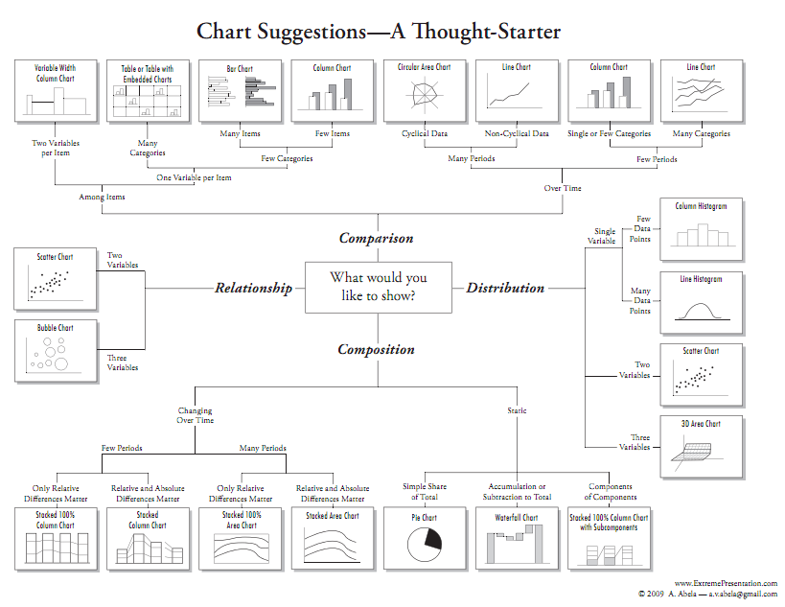
Chart selection
Notes:
Choose your chart carefully!
For your toilet perusal

Slide 12
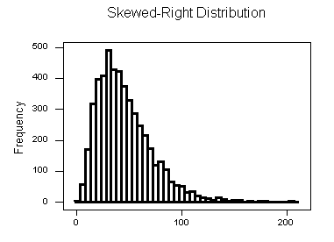
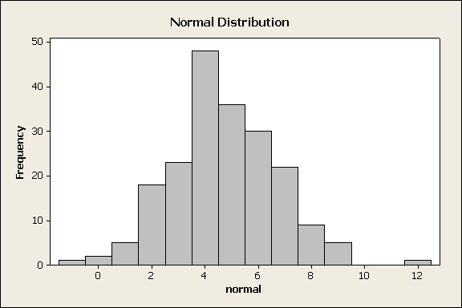
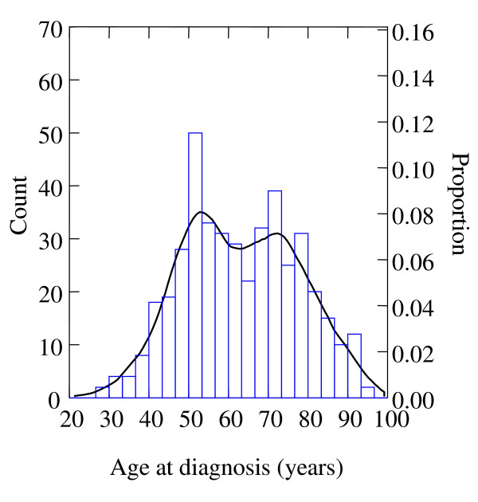
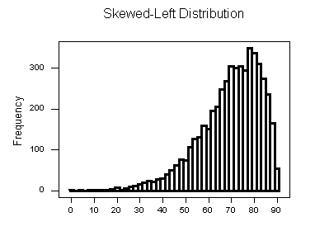
One variable: histograms
Histograms can tell you a lot about a single variable, discrete or continuous
Easy to recognize skewed distributions!
Smoothed histogram (a.k.a. kernel density estimate)
Notes:
x: (discretized) values; y: counts
Categorical variable with no meaningful ordering → “barchart” (with gaps)

Slide 13
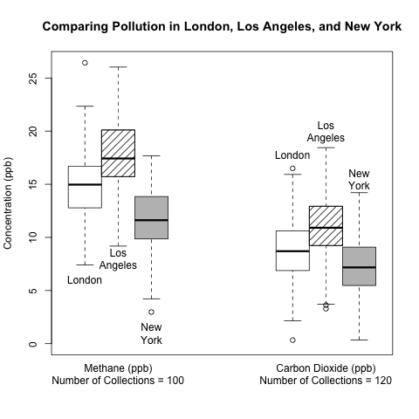
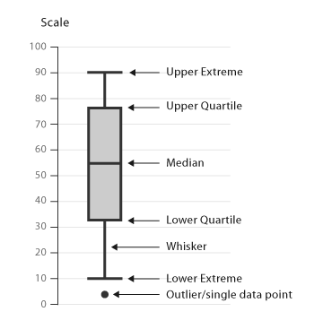
One variable: box plots
Notes:
A way to compress histogram into visually simpler form
→ easy to show multiple distributions side by side
Half of LA’s measurements are above NY’s worst measurement
NY not quite as bad as implied by Garden of Eden
Important that readers understand what the plot elements (boxes, whiskers, outliers, etc.) mean (not CIs!).
Big journals (e.g., PNAS) require explaining it under every plot

Slide 14
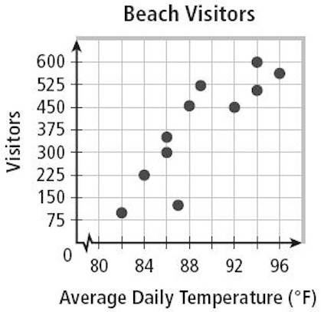
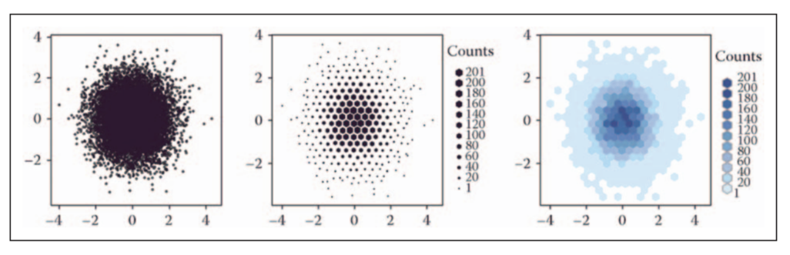
Two variables: scatter plots
Scatter plots quickly expose the relationships between two variables
a.k.a. heatmap
2D histograms
Notes:
2D histograms: instead of using one of the axes to show counts/probs, we use a different type of info: size or color (think of those as representing height of a bar coming toward you out of the slide)

Slide 15
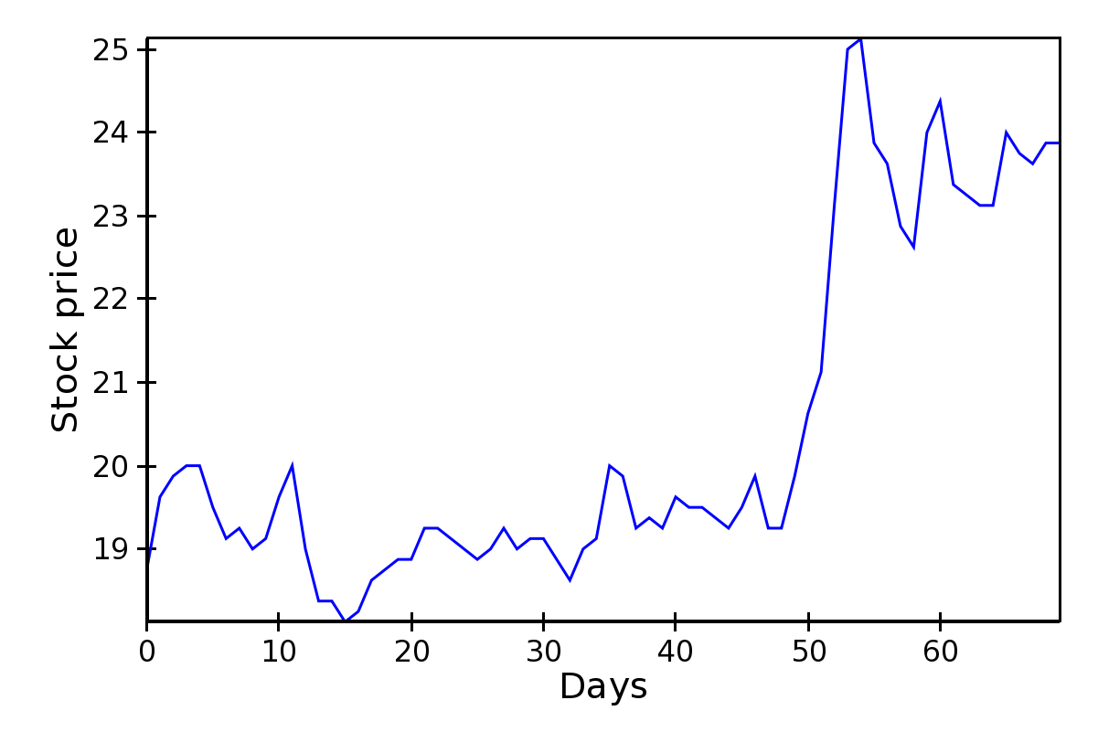
Two variables: line plots
If relationship is functional (for instance, after binning and aggregating)
Notes:
E.g. time series
You can always get a function relationship by aggregating everything w/ the same (or a similar) x-value

Slide 16
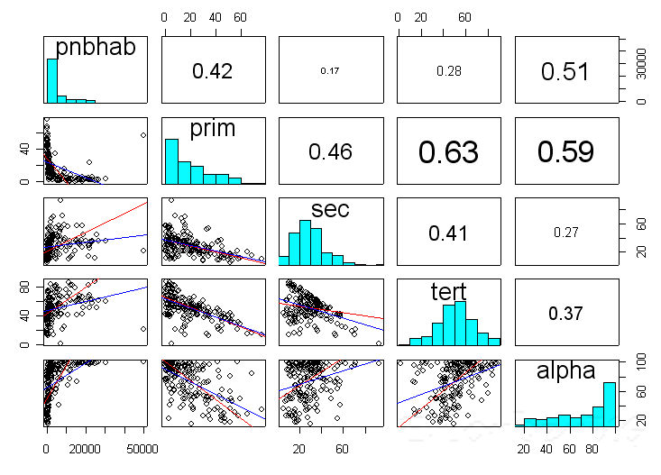
> 2 variables: scatter plot matrix

Slide 17
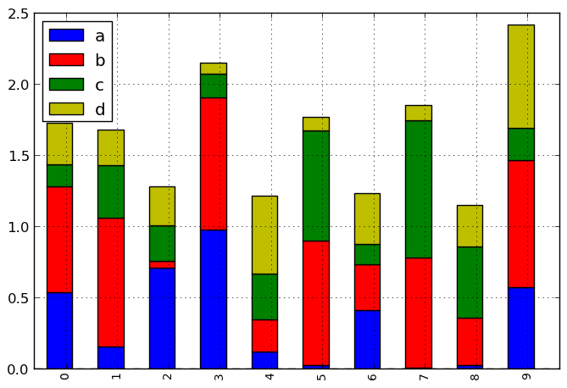
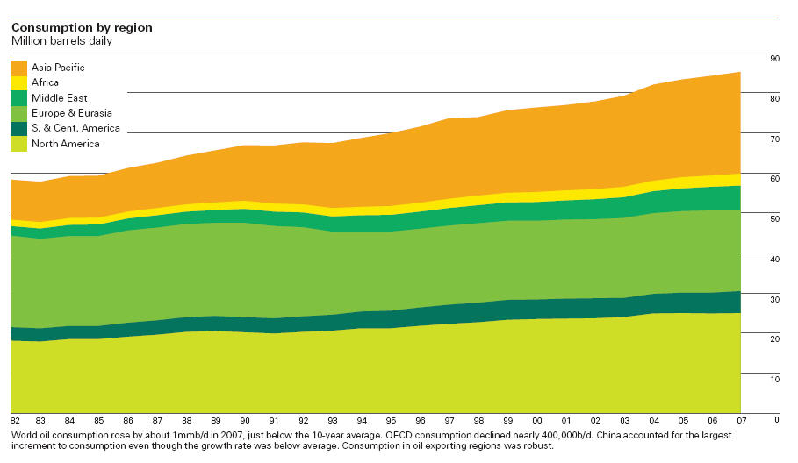
> 2 variables: stacked plots
Here: 3 variables: stack index, height, color
Stack variable and color variables categorical,
height variable continuous:
Color variable categorical,
stack and height variables continuous:
Notes:
Left e.g.:
stacks = constituencies
colors = parties
height = vote shares
Right e.g.:
stacks = time
colors = parties
height = vote shares

Slide 18

Dimensionality reduction
For example, PCA: allows visualization of high-dimensional continuous data in 2D using principal components
The principal components are the strongest (highest variation) dimensions in the dataset, and are orthogonal
Notes:
What if you have more than 3 dims?
Often high-dim data lies in a lower-dim subspace (see ex.)
PCA allows you to find that subspace
More generally, for any lower-than-original dim k, PCA gives you the subspace of dim k that captures the orig data as faithfully as possible
More technically, PCA identifies the directions in high-dim space along which the data varies most, called PCs (orthogonal, linearly indep; cf. ex.)

Slide 19
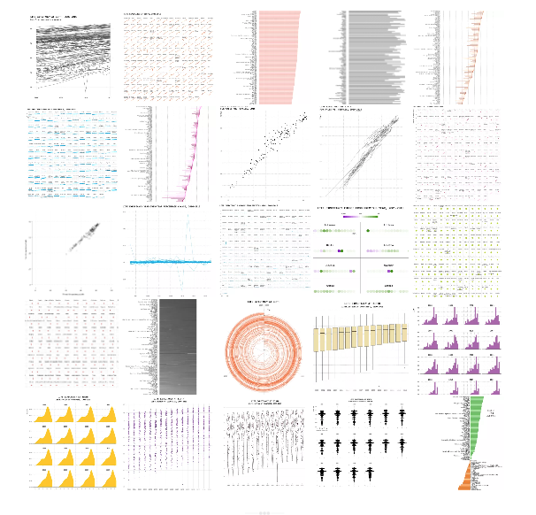
One dataset, visualized 25 ways
http://flowingdata.com/2017/01/24/one-dataset-visualized-25-ways
“You must help the data focus and get to the point. Otherwise, it just ends up rambling about what it had for breakfast this morning and how the coffee wasn’t hot enough.”
Notes:
For a more complete account of the types of plots out there, check this out!
25 ways of visualizing the same dataset – both good and bad
The wrong viz might be worse than no viz at all
(quote)
(segue to Part 2: principles and best practices)

Slide 20
Part 2
Principles and best practices

Slide 21
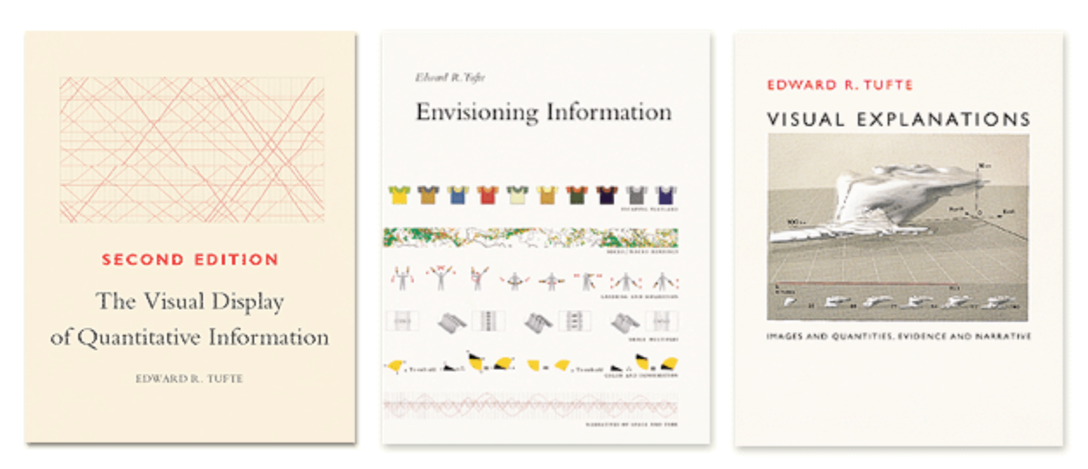
Instructive coffee table books by Edward Tufte
[another great coffee table book]

Slide 22
Perception of magnitudes
(134, 134, 134)
(144, 144, 144)
Which is brighter?

Slide 23
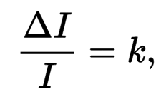


Just noticeable difference (JND)
Weber’s law:
I: intensity; ΔI: increase from I to notice a difference; k: constant
Required increase ΔI depends on original intensity I
Most continuous variations in stimuli are perceived in discrete (multiplicative) steps
Notes:
Discovered by physicist Ernst Weber in 1846
Stimulus intensity I (e.g., brightness, loudness, skin pressure)
JND (\Delta I): the increase in intensity required for a human to notice the difference
JND is proportional to the magnitude of the original intensity I of the stimulus. So as the base I increases we require a larger changes in \Delta I to notice the change.
Example: 10 → 20; 100 → 200

Slide 24
Compare area of circles

Slide 25
Compare area of circles

Slide 26
Perception of magnitudes
Most accurate Position
Length
Slope
Angle
Area
Volume
Least accurate Color hue-saturation-density
Cleveland & McGill (1984)
Graphical Perception: Theory, Experimentation, and Application to the Development of Graphical Methods
Notes:
Magnitudes can be represented using various graphical means:
…
Best practice #1: Try to find the simplest (upmost in this plot) viz dimension that gets your point across

Slide 27
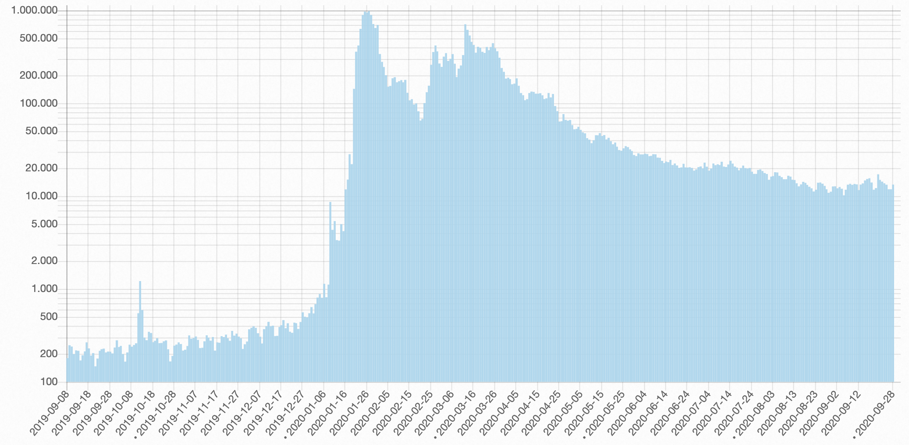
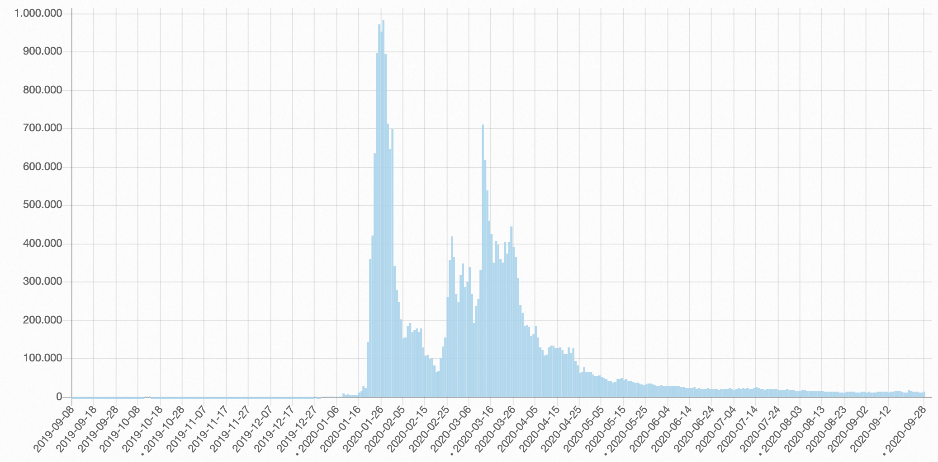
Choose your axes wisely!
Time series of pageviews
of Wikipedia article about “Coronavirus”
(linear y-axis)
(logarithmic y-axis)
[link]
Notes:
Linear: looks like massive explosion happens after red bar
Only log axis shows that exponential phase is already in full swing at red bar
Recurring theme in ADA: log is your friend!

Slide 28
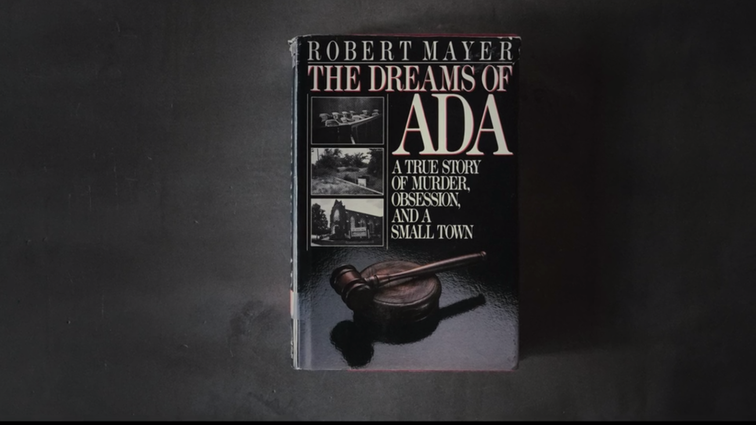
Commercial break

Slide 29
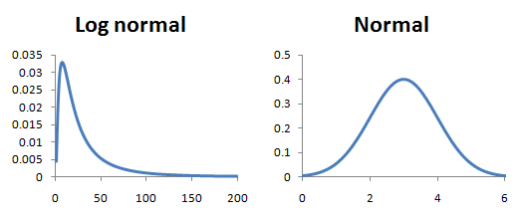
Choose your axes wisely:
Visualizing heavy-tailed distributions
Linear x-axis
Logarithmic x-axis
Notes:
Technical definition: tail falls off asymptotically slower than exponentially
In practice: Mean >> median
but not due to single outliers: remove one outlier → next one will hit you
A lot of interesting stuff happens in the tail -- how can we make it visible?
Log is your friend: log x-axis!

Slide 30
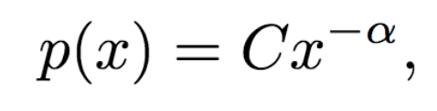
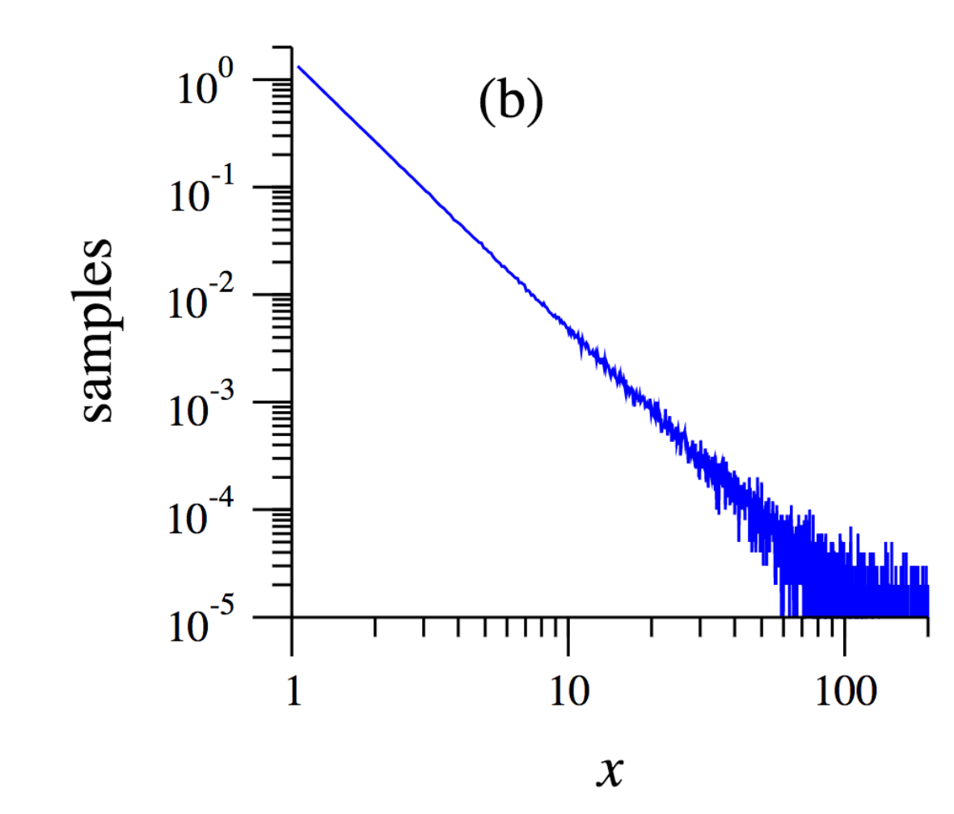
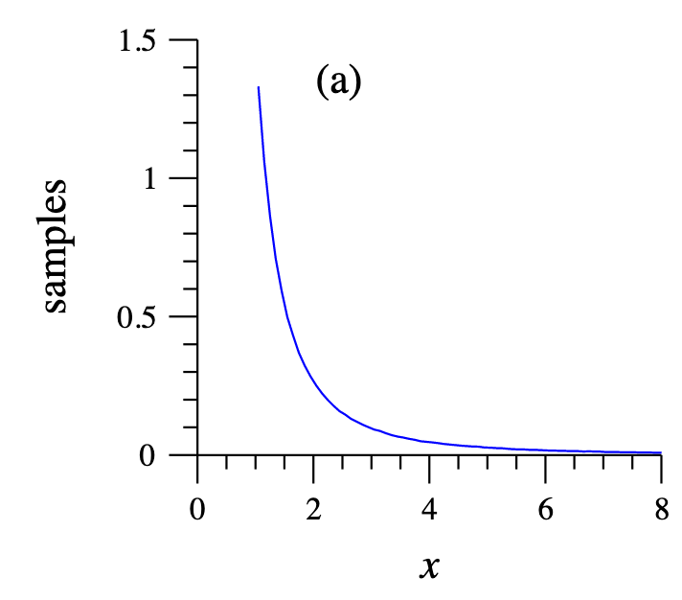
Heavy-tailed data: power laws
Probability of x:
Very large values are rare, “but not very rare”
Body size vs. city size
Many natural phenomena are power laws (e.g., # of friends)
For dealing with them, need to know some tricks
E.g., for small α, mean & var = ∞ → use median!
E.g., straight line on log-log axes:
y = C x^{–α} ↔ log(y) = log(C) – α log(x)
PDF
Notes:
This brings us to the topic of PLs
…
\alpha <= 2: mean & var = \infty
\alpha <= 3: var = \infty
most identified power laws in nature have exponents such that the mean is well-defined but the variance is not

Slide 31
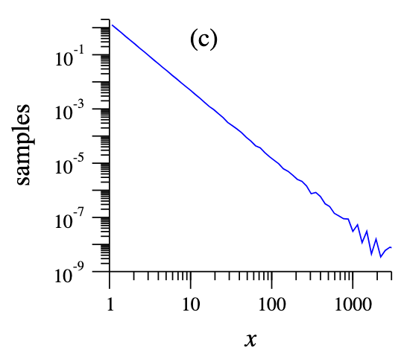


Heavy-tailed data: power laws
POLLING TIME
“What shape does the CCDF of a power law have when plotted on log-log axes?”
Scan QR code or go to https://web.speakup.info/room/join/66626
Complementary cumulative distribution function (CCDF): P(x) := Pr{X >= x}
PDF
(with binned x-axis)
PDF
Notes:
PDF: noisy tail, due to rare values
Approach 1: binning in increasing bucket sizes
Approach 2: use CCDF
Let’s see if you can figure out why!
(POLL)
What shape does the CCDF of a power law have when plotted on log-log axes?
(A) Concave shape (like a logarithm or square root)
(B) Straight line
(C) Convex shape (like an exponential)

Slide 32
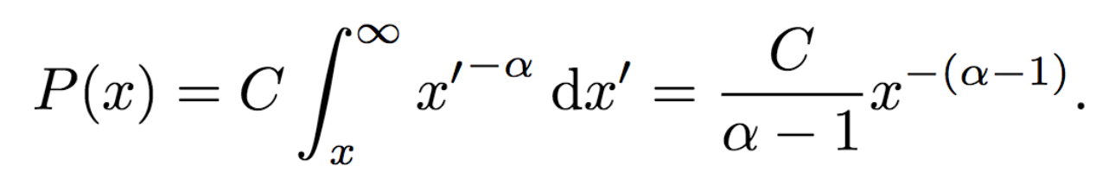
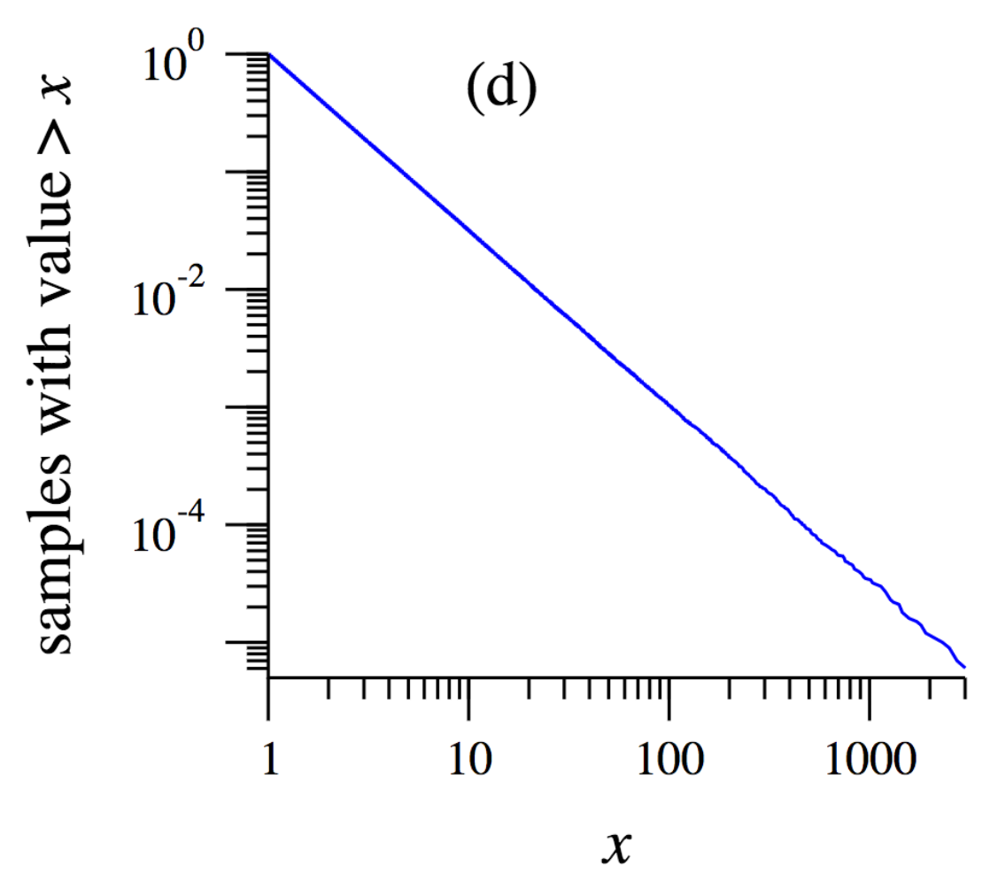
Heavy-tailed data: power laws
Complementary cumulative distribution function (CCDF): P(x) := Pr{X >= x}
CCDF of power law is also a power law (with exponent α – 1)
CCDF plot is monotonically decreasing (even without binning)
PDF
(with binned x-axis)
PDF
CCDF
Notes:
…
(source of plots, and more about power laws: https://arxiv.org/pdf/cond-mat/0412004.pdf)

Slide 33
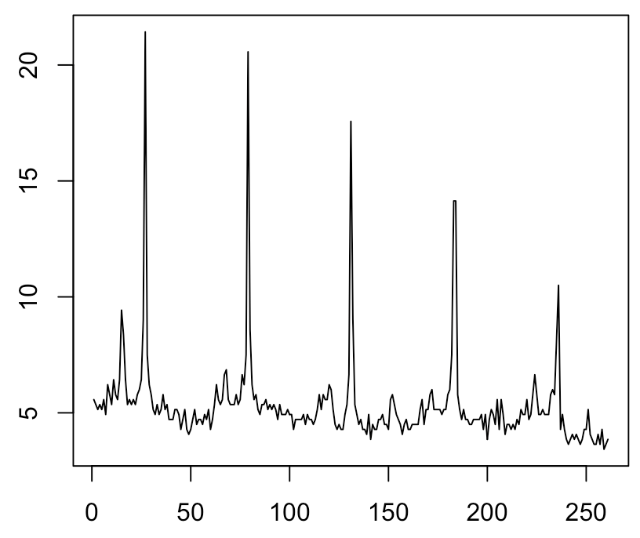
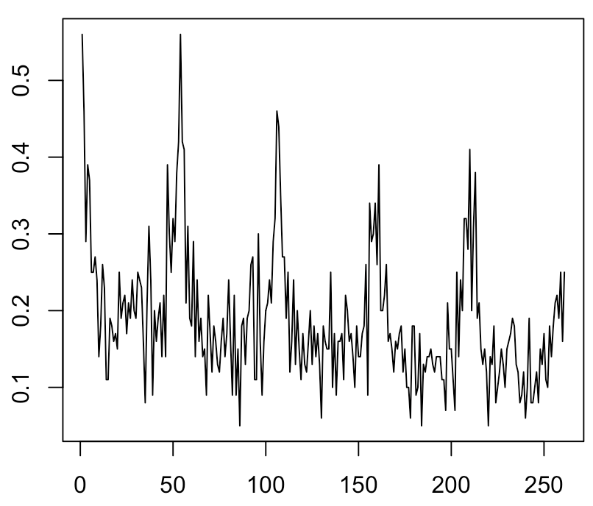
Answer fast: which time series has a higher mean value?

Slide 34
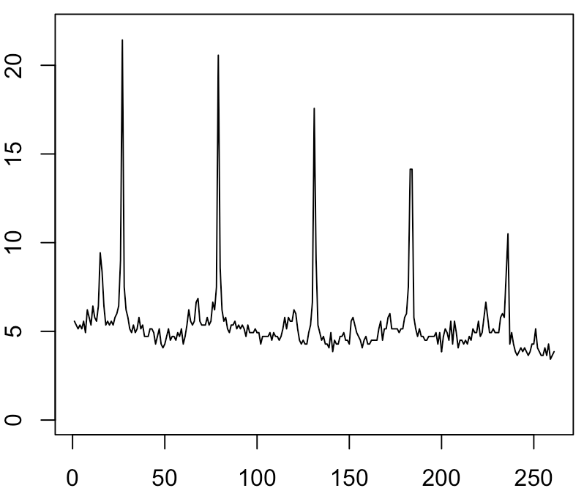
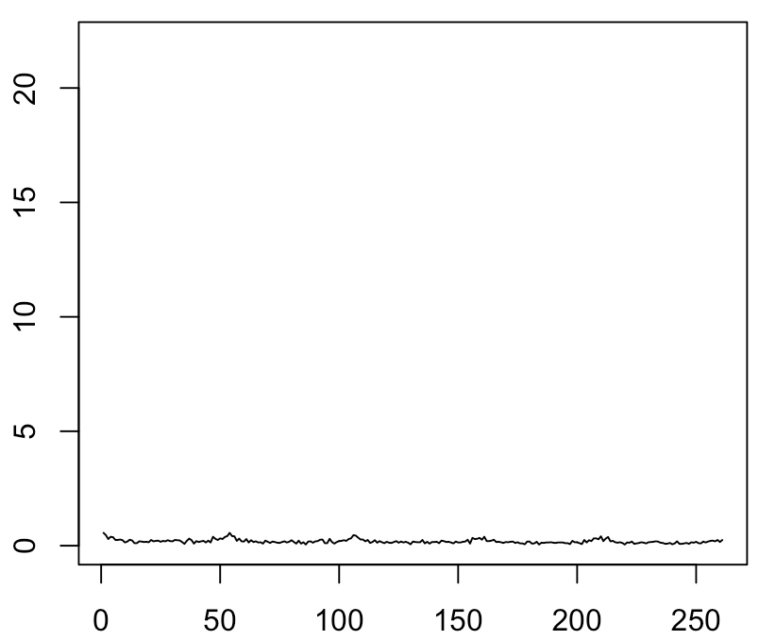
Use consistent axes!
Answer fast: which time series has a higher mean value?

Slide 35
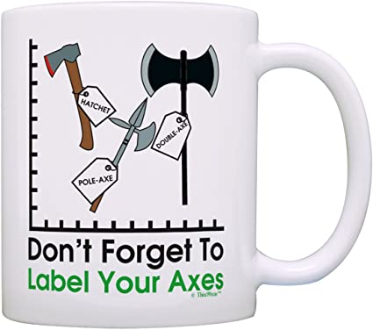

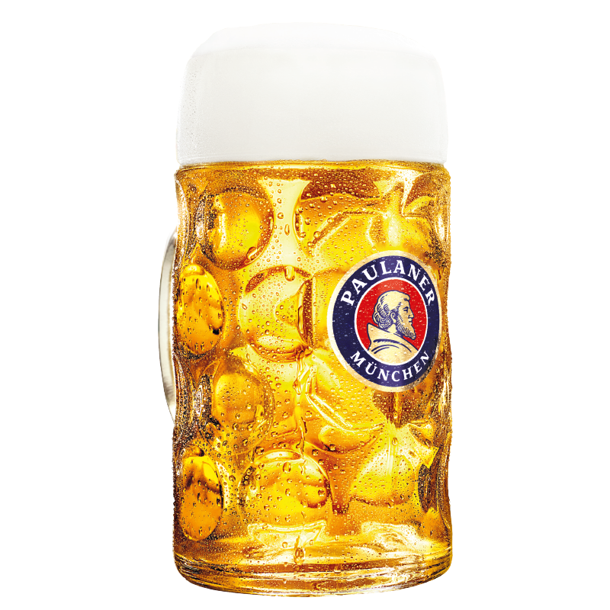
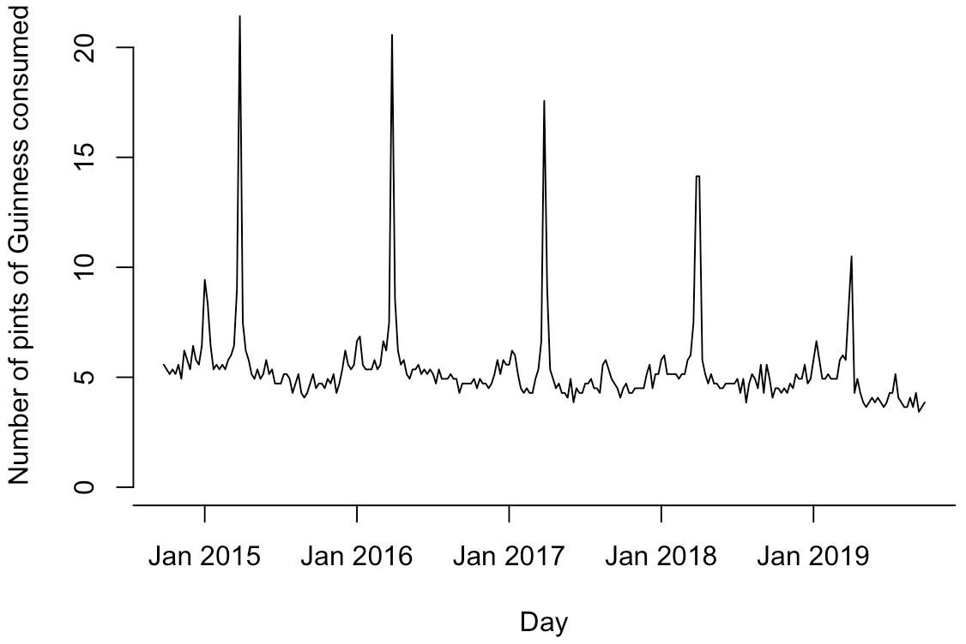
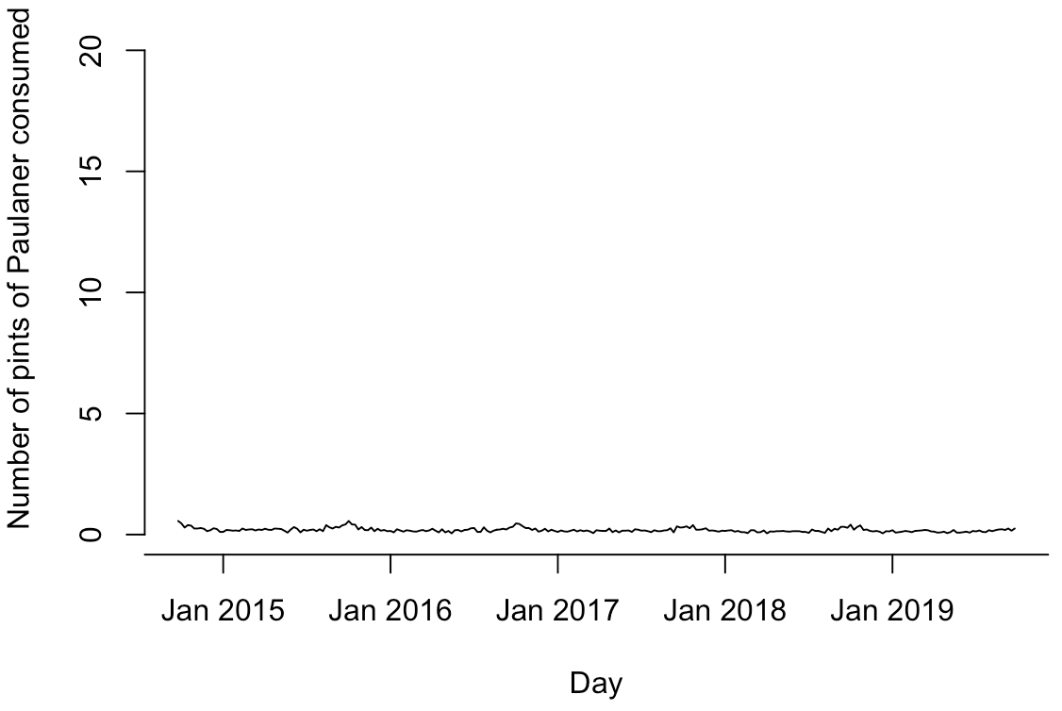
Label your axes!
Notes:
Without labeling your axes, your plot is meaningless
It’s obvious, but people forget → consider getting this mug
Side note: axes are now on same scale, but beer glasses are not (Paulaner is twice as large…)

Slide 36
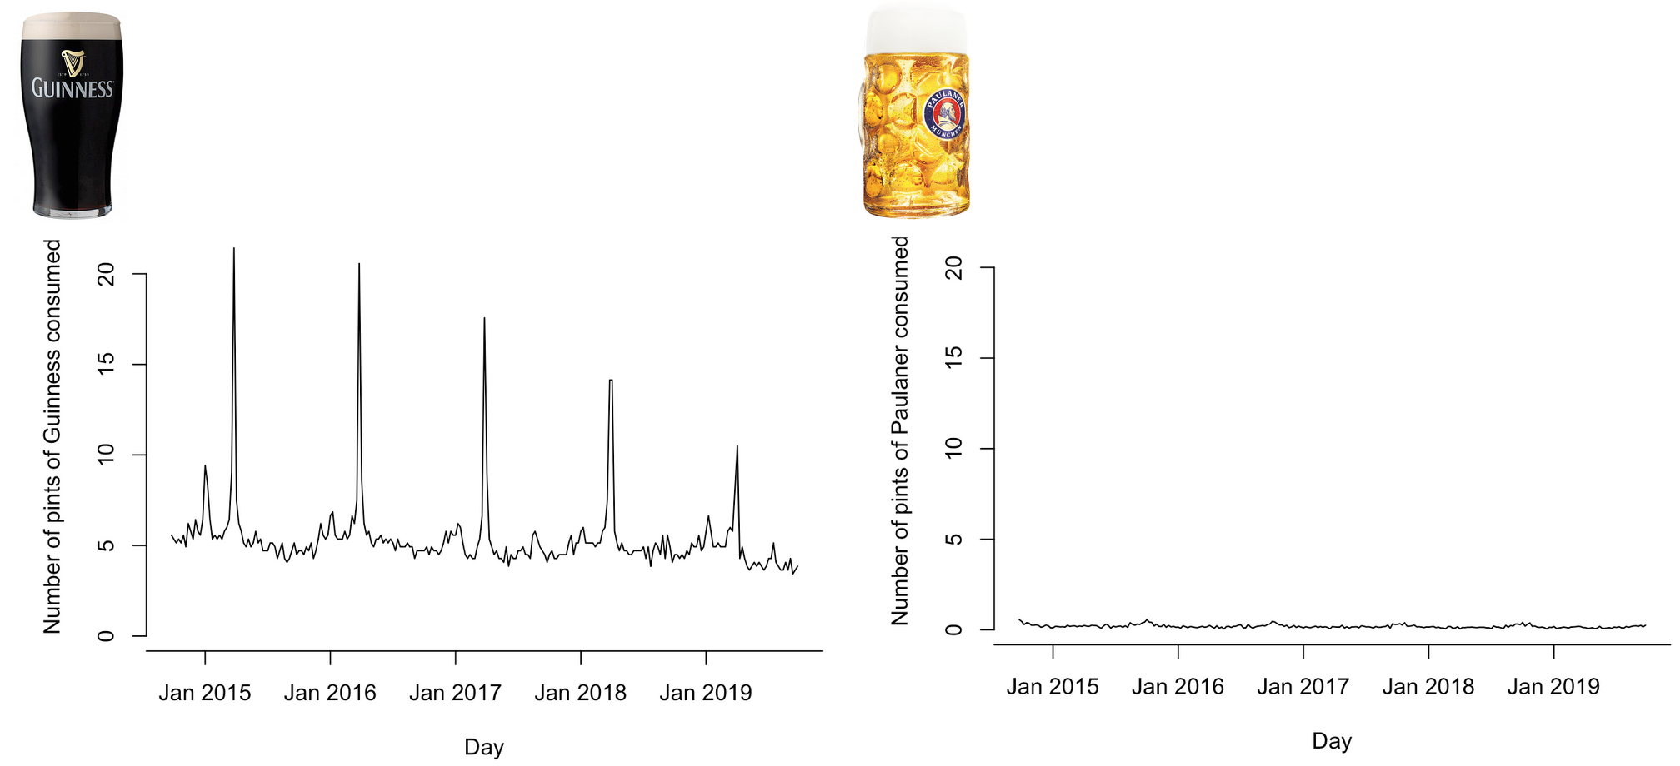
THINK FOR A MINUTE: .
How could we show details of both time series without using
different y-axes?
(Feel free to discuss with your neighbor.)

Slide 37

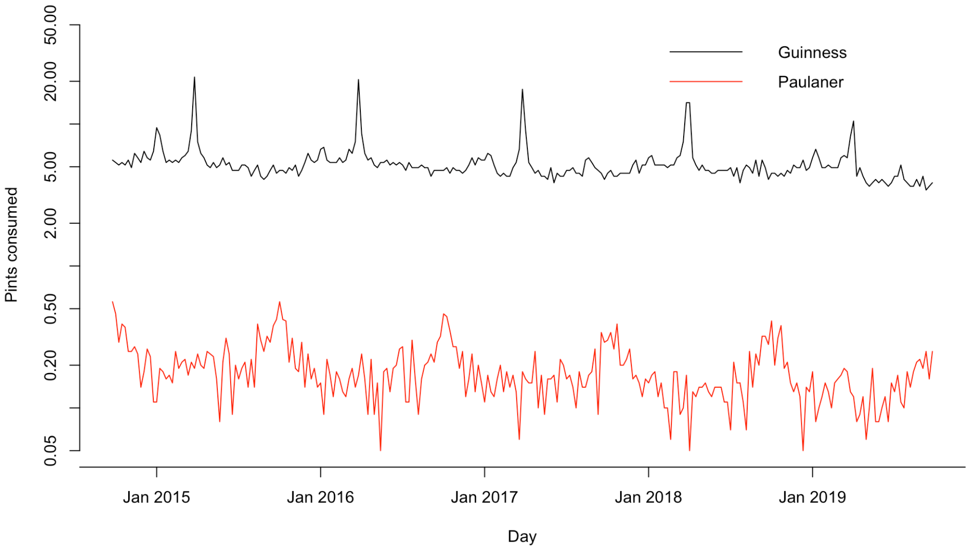
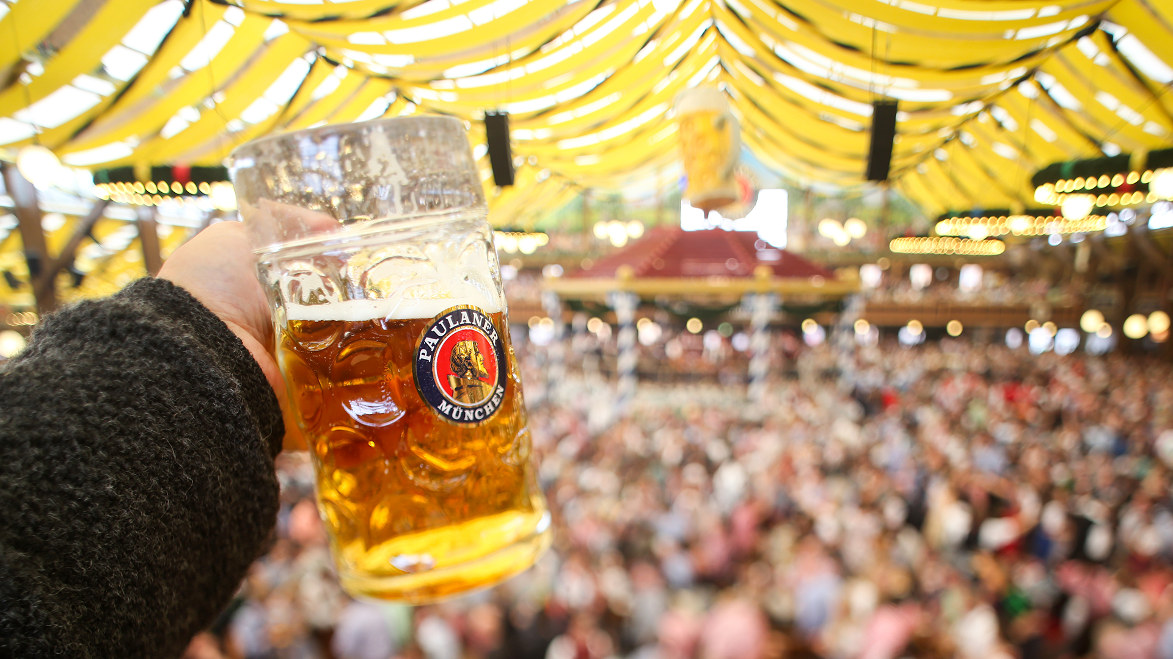
logarithmic!
Notes:
log y instead of y
Going up a fixed #cm on y axis = multiplying y with a fixed factor

Slide 38
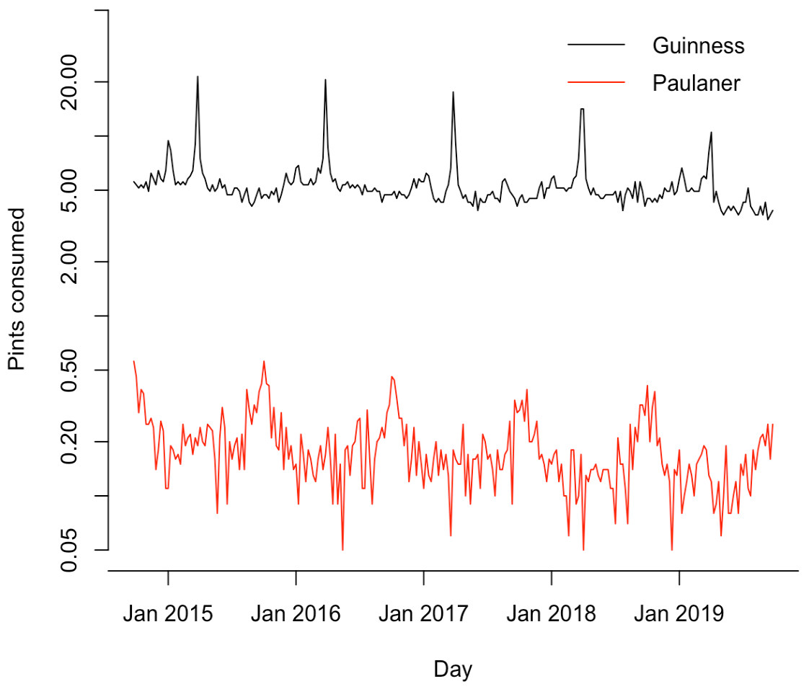
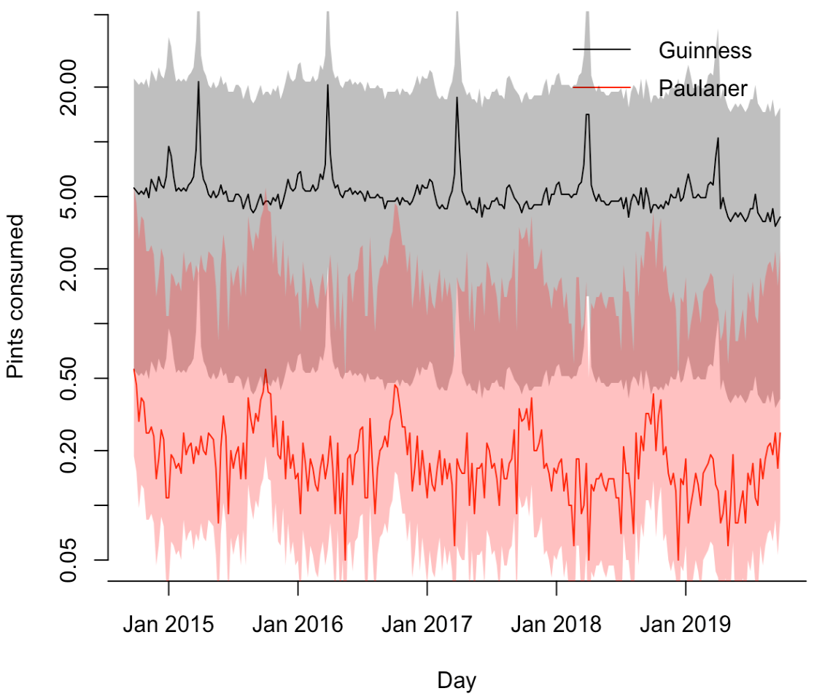
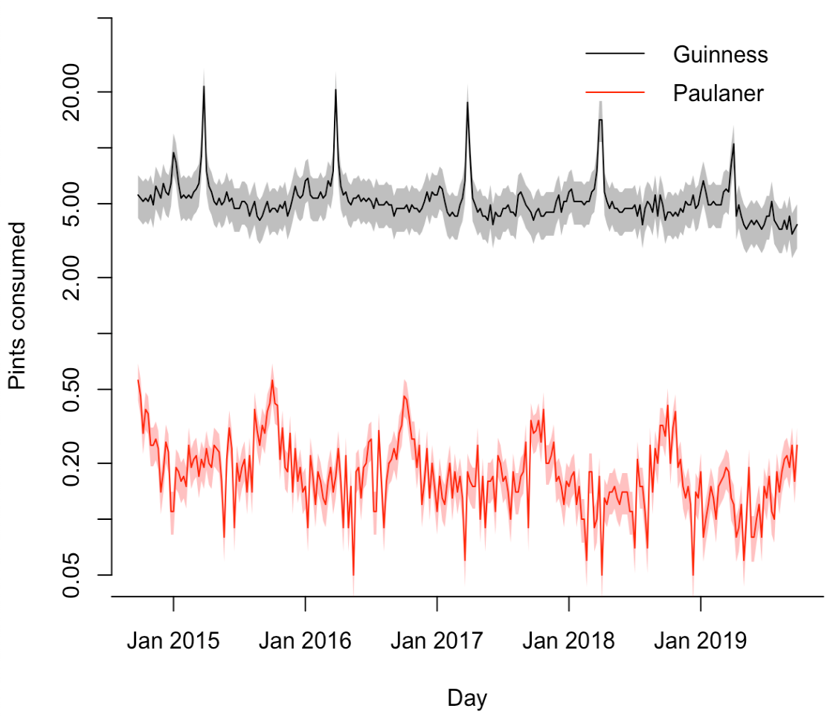
Show data uncertainty!
Which beer is more popular, Guinness or Paulaner?
“error bars”
Notes:
How to compute error bars? Next lecture!

Slide 39
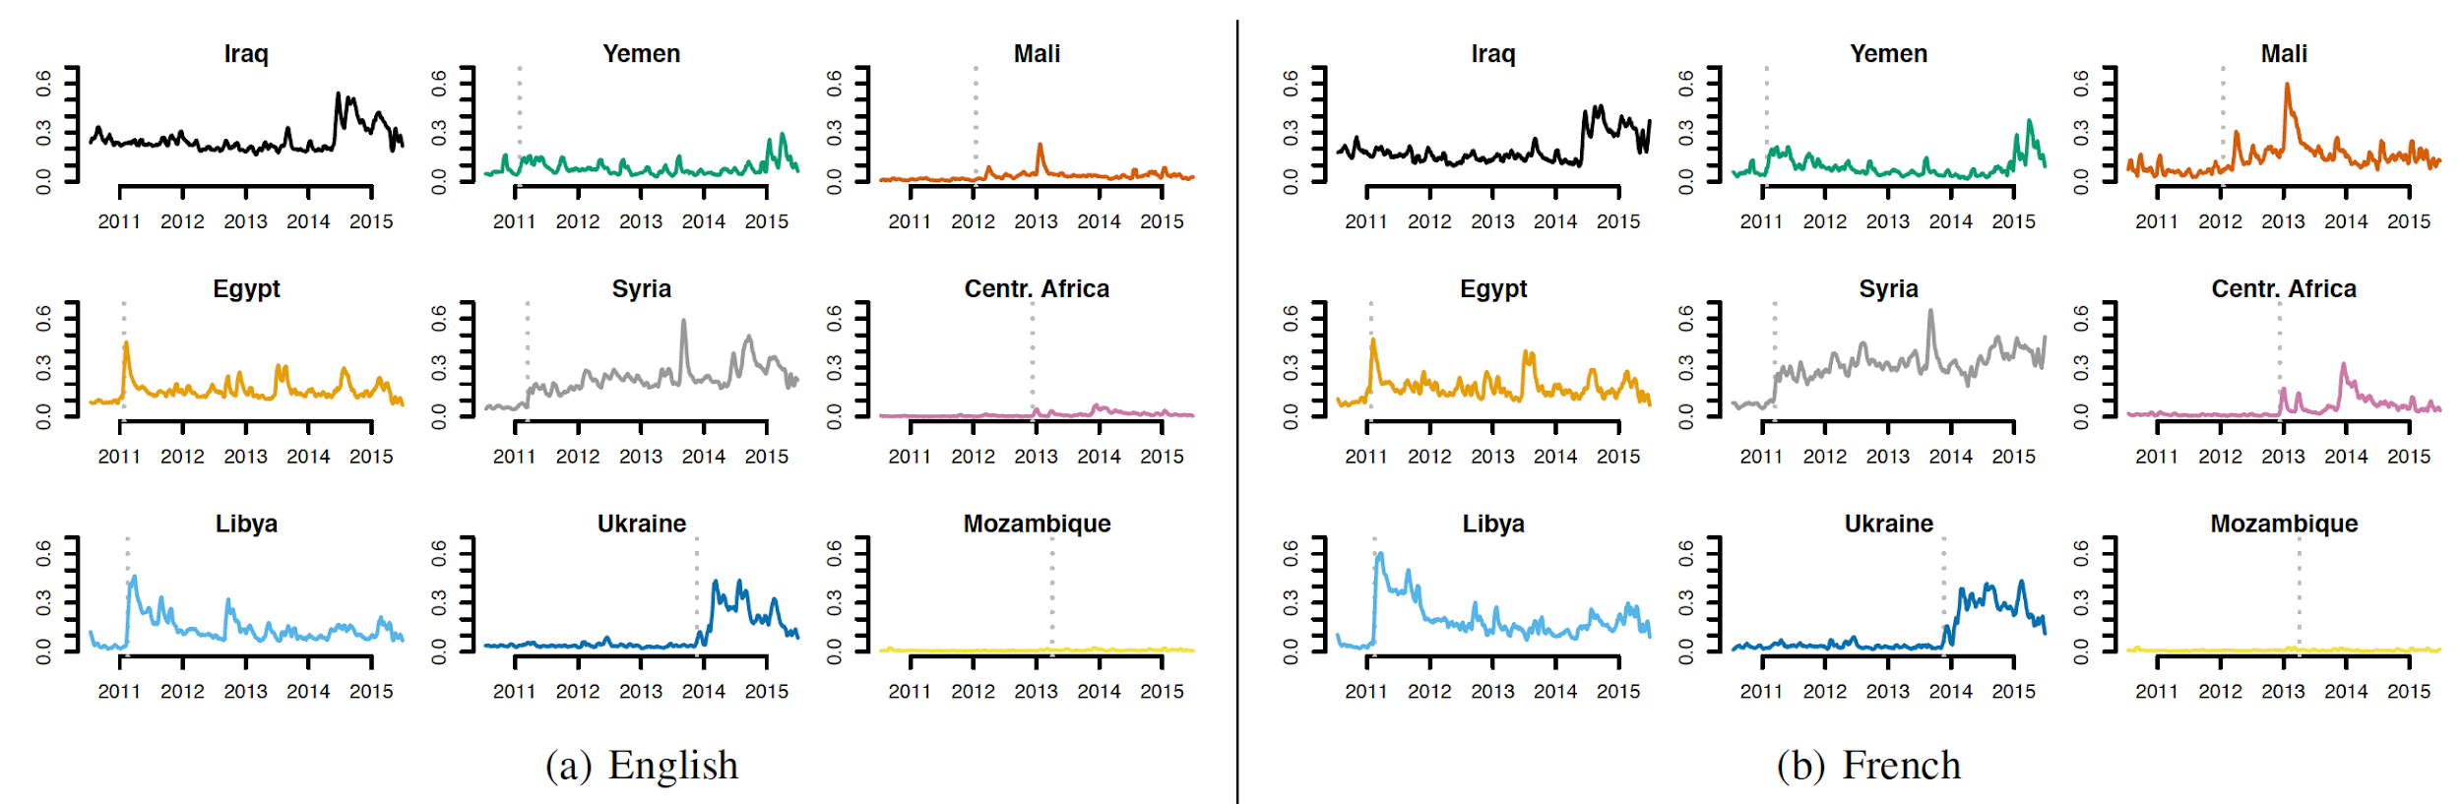
Consider using small multiples!
Use colors consistently!
Media attention
[link]
Notes:
Note consistent y-axis ranges!
Note consistent colors: 1 color ←→ 1 country
Meta level: note how I used green consistently to make it clear that the green circles are supposed to exemplify how to use colors consistently

Slide 40
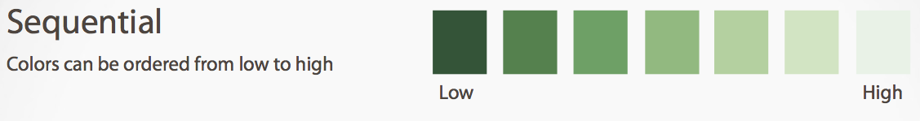
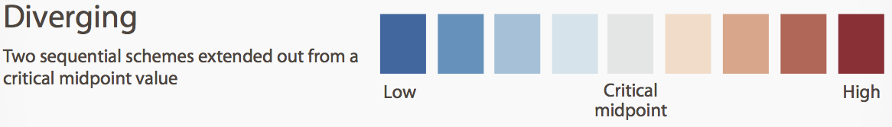

Use colors wisely!
Choose colors based on the information you want to convey

Slide 41
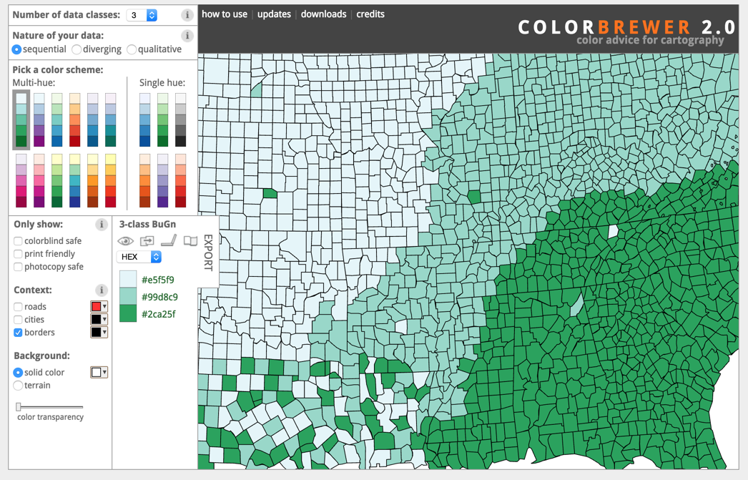
Notes:
Use online resources to find the best color schemes; e.g.,
Color Brewer
Kuler
Colour Lovers
Point out “colorblind safe”

Slide 42
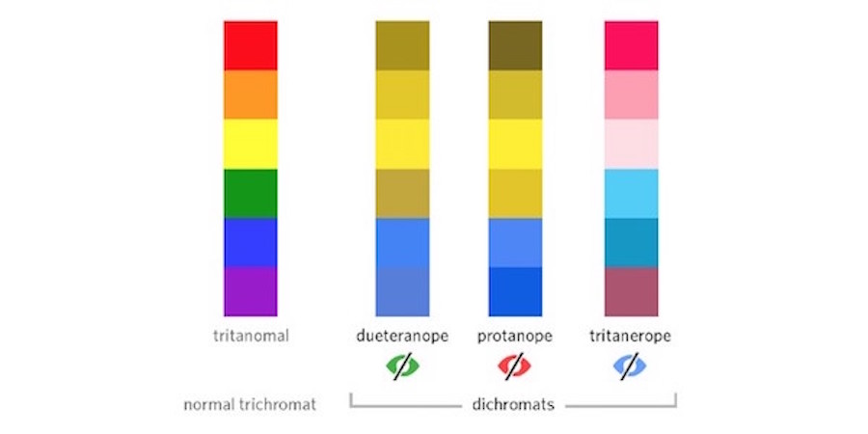
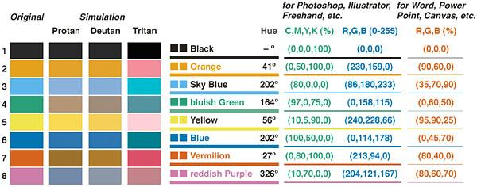
Use colorblind-safe palettes!
Remember: 10% of males have some form of colorblindness
Notes:
Rainbow colors a horrible choice for a colorblind audience
On that note: traffic light colors also stupid (should be yellow/blue, not red/green)
Horrible: Matlab uses red/green as default colors
Instead: use colorblind-safe palettes

Slide 43

Use data ink wisely! Avoid chart junk!
Notes:
https://image.slidesharecdn.com/slidesharematerialstatistical-chartscsp-150306103804-conversion-gate01/95/using-charts-to-present-statistical-data-to-nonstatisticians-5-638.jpg

Slide 44





Toilet exercise: Which principles and best practices do these graphics violate?
Courtesy of viz.wtf
Notes:
(Don’t discuss in class!)
Some of them violate principles that we discussed, others are wrong in other ways. Have fun!

Slide 45
Part 3
A (small) selection of use cases
for data visualization

Slide 46








Use case:
Presenting scientific results
Notes:
Everything we’ve seen in this lecture so far
Sometimes hard to distinguish from art (see pics; also cf. “Garden of Eden”)

Slide 47

Multimodal data
Use case:
Data wrangling
Two or more distinct peaks in a histogram often suggest 2 or more distinct populations of samples.
But don’t guess! Explore further by using, e.g., color and a histogram of multiple populations (p.t.o.).

Slide 48

Multimodal data
Use case:
Data wrangling
Explore further by using, e.g., color and a histogram of multiple populations

Slide 49



Weird data
Use case:
Data wrangling
Maintain a theory of what the data should look like.
Some data is very hard to explain.
Never just blink it away!
First, assume a bug. Try to fix it.
If not a bug: you might have made an interesting discovery!
Some of science’s most important findings were made by not ignoring weird data, but dwelling on it!
[link]
Notes:
Never just blink the weirdness away; stare it straight in the eye
…
“No good or bad in science”; you try to find what the world is like
Famous example: Hubel & Wiesel’s cat experiments

Slide 50

Use case:
Journalism
NY Times interactive visualizations (recession/recovery 2014) http://www.nytimes.com/interactive/2014/06/05/upshot/how-the-recession-reshaped-the-economy-in-255-charts.html
And 2014 “the year in interactive storytelling”
http://www.nytimes.com/interactive/2014/12/29/us/year-in-interactive-storytelling.html?_r=0
NY Times graphics are a great source of best practices in viz (except for when they’re not…)
Notes:
(links unfortunately behind paywall now – but CANCEL trick…)

Slide 51

Use case:
Educating the public
Hans Rosling:
200 countries, 200 years, 4 minutes
https://www.youtube.com/watch?v=jbkSRLYSojo

Slide 52

Charles Joseph Minard 1869 Napoleon’s march
Use case:
Give new perspectives
According to Tufte: “It may well be the best statistical graphic ever drawn.”
5 variables: army size, location, dates, direction, temperature during retreat
Notes:
We’ll end with a look into the crystal ball
ADA class over course of semester ;)
…
Reason for slide title: “Give new perspectives”
Groundbreaking: from perspective of soldier, not generals or politicians

Slide 53
Tools
(remaining slides for your personal perusal)
Notes:
Next slides provide pointers to specific tools
Won’t discuss in class
Feel free to follow up on these pointers yourself

Slide 54
Interactive toolkits: D3
Without doubt, the most widely used interactive visualization framework is D3.
Note from the authors: D3 is intentionally a low-level system. During the early design of D3, we even referred to it as a "visualization kernel" rather than a "toolkit" or "framework"

Slide 55

Interactive toolkits: Vega
Vega is a “visualization grammar” developed on top of D3.js
It specifies graphics in JSON format.

Slide 56


Interactive toolkits: Vincent
Vincent is a Python-to-Vega translator.
Trivia question: why is it called Vincent? Hint: Vincent+Vega= ?

Slide 57

Interactive toolkits: Vincent
Vincent is a Python-to-Vega translator.
Trivia question: why is it called Vincent? Hint: Vincent+Vega= ?

Slide 58

Bokeh: another interactive viz library
Bokeh is an independent Viz library focused more heavily on big data visualization. Has both Python and Scala bindings.

Slide 59

Visualizing maps: Folium
More in tomorrow’s lab session!

Slide 60
Feedback
Give us feedback on this lecture here: https://go.epfl.ch/ada2023-lec3-feedback
What did you (not) like about this lecture?
What was (not) well explained?
On what would you like more (fewer) details?
What’s your favorite color, baby?
…

Slide 61


> 2 variables: parallel-coord. plots
Color, x, y
Color variable is categorical, others arbitrary
Notes:
Personally don’t like this: x-axis seems to have meaningful ordering, but doesn’t
→ p.t.o.

Slide 62

> 2 variables: radar charts
Similar to parallel-coord. plots
Doesn’t pretend that x axis has meaningful order
Also good for periodic data

Slide 63
Heavy-tailed data: power laws
Smart trick for plotting CCDF of any distribution:
x-axis: data sorted in ascending order
y-axis: (n:1)/n (where n is number of data points)
CCDF

Slide 64

Interactive chart design: simplifying
With interactive charts you can keep things very simple by hiding and dynamically revealing important structure.
On an interactive chart, you reveal the information most useful for navigating the chart.

Slide 65


Use structure!
Gestalt psychology principles (1912)
Notes:
red/green: worst colors (as per previous slide)...

Slide 66

A case for ugly visualizations
People instinctively gravitate to attractive visualizations, and they have a better chance of getting on the cover of a journal.
But does this conflict with the goals of visualization?
Rapid exploration
Focus on most important details
Easy and fast to develop and customize

Slide 67
Guide your audience!
17th March (St. Patrick’s day)

